Slide 1

Real Estate Data Analysis
Melissa Djohan
Limei Hou
Indira Poovambur

Slide 2


Slide 3
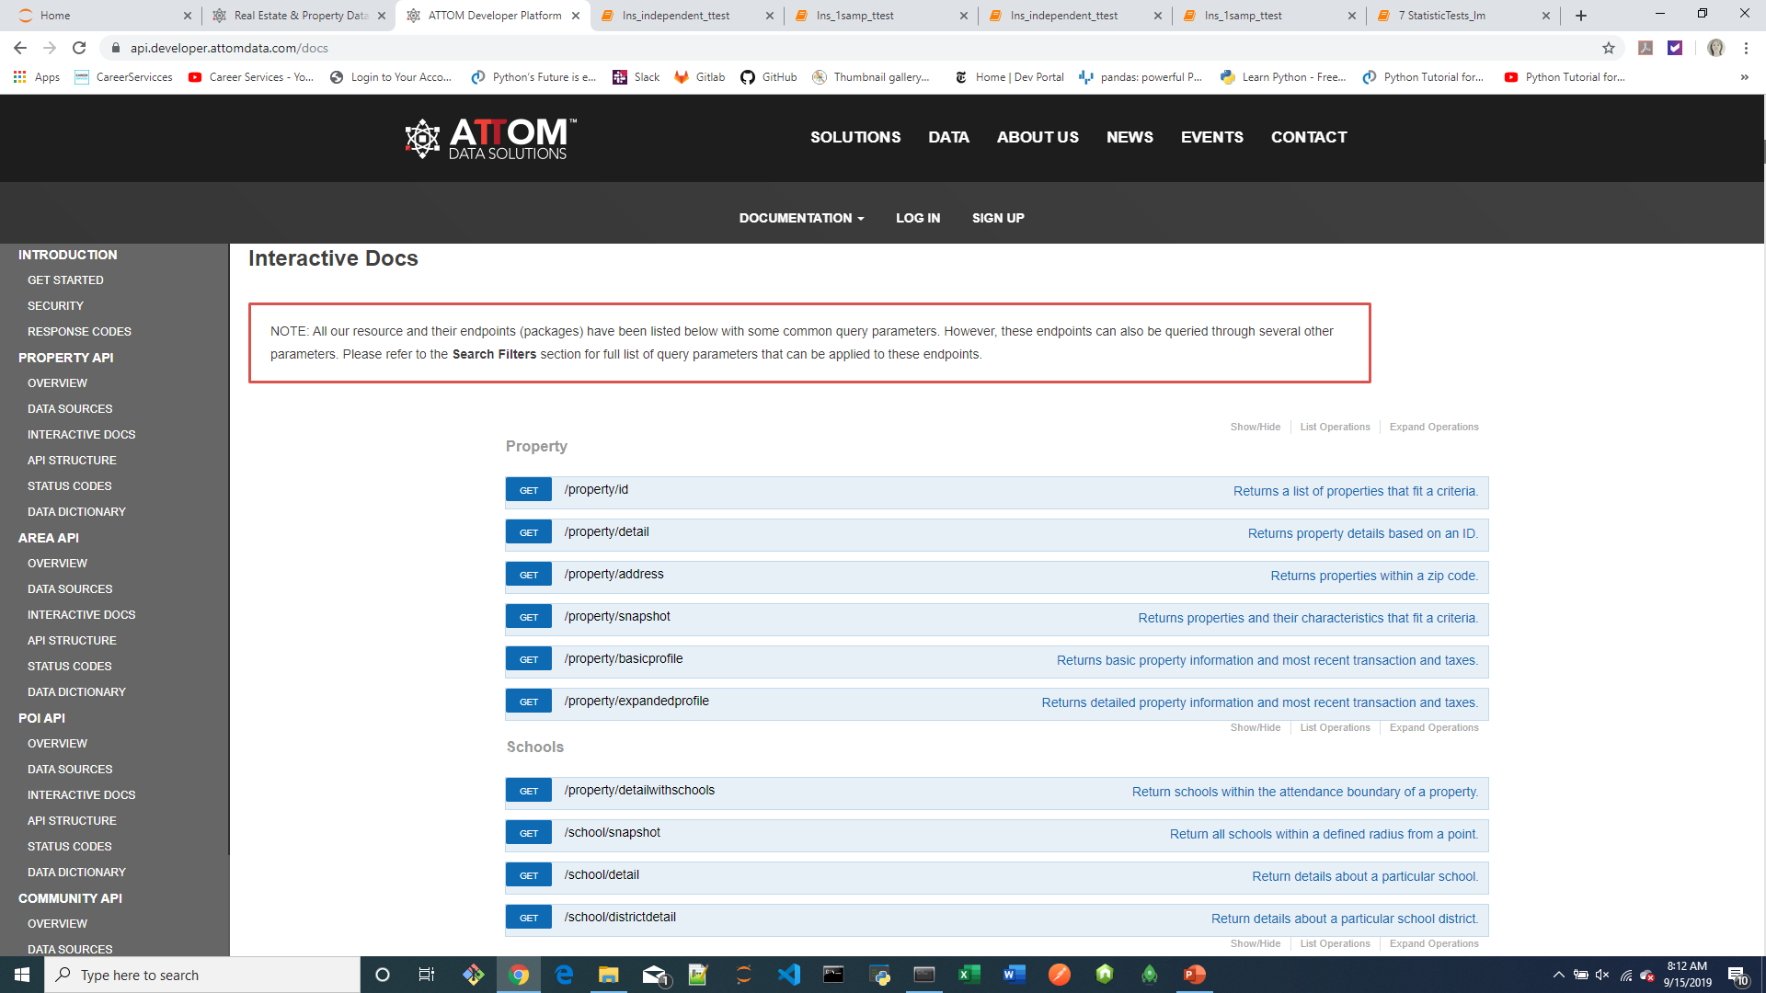
Study API End Points: Interactive Docs

Slide 4
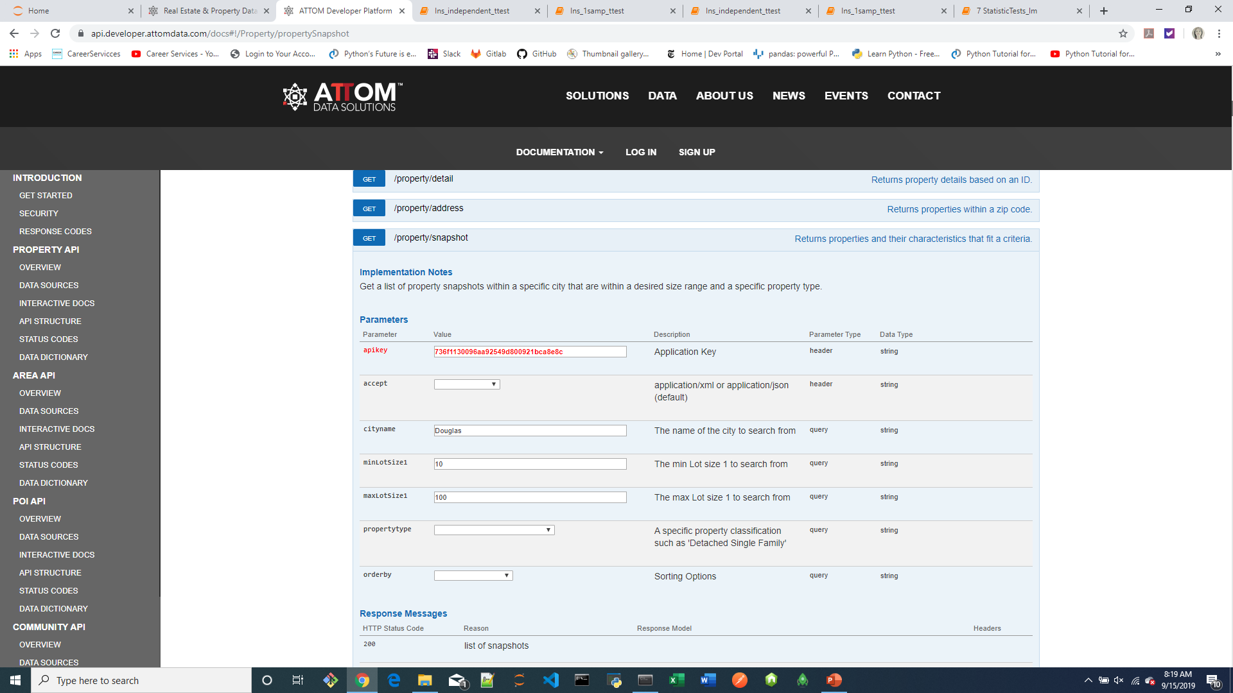
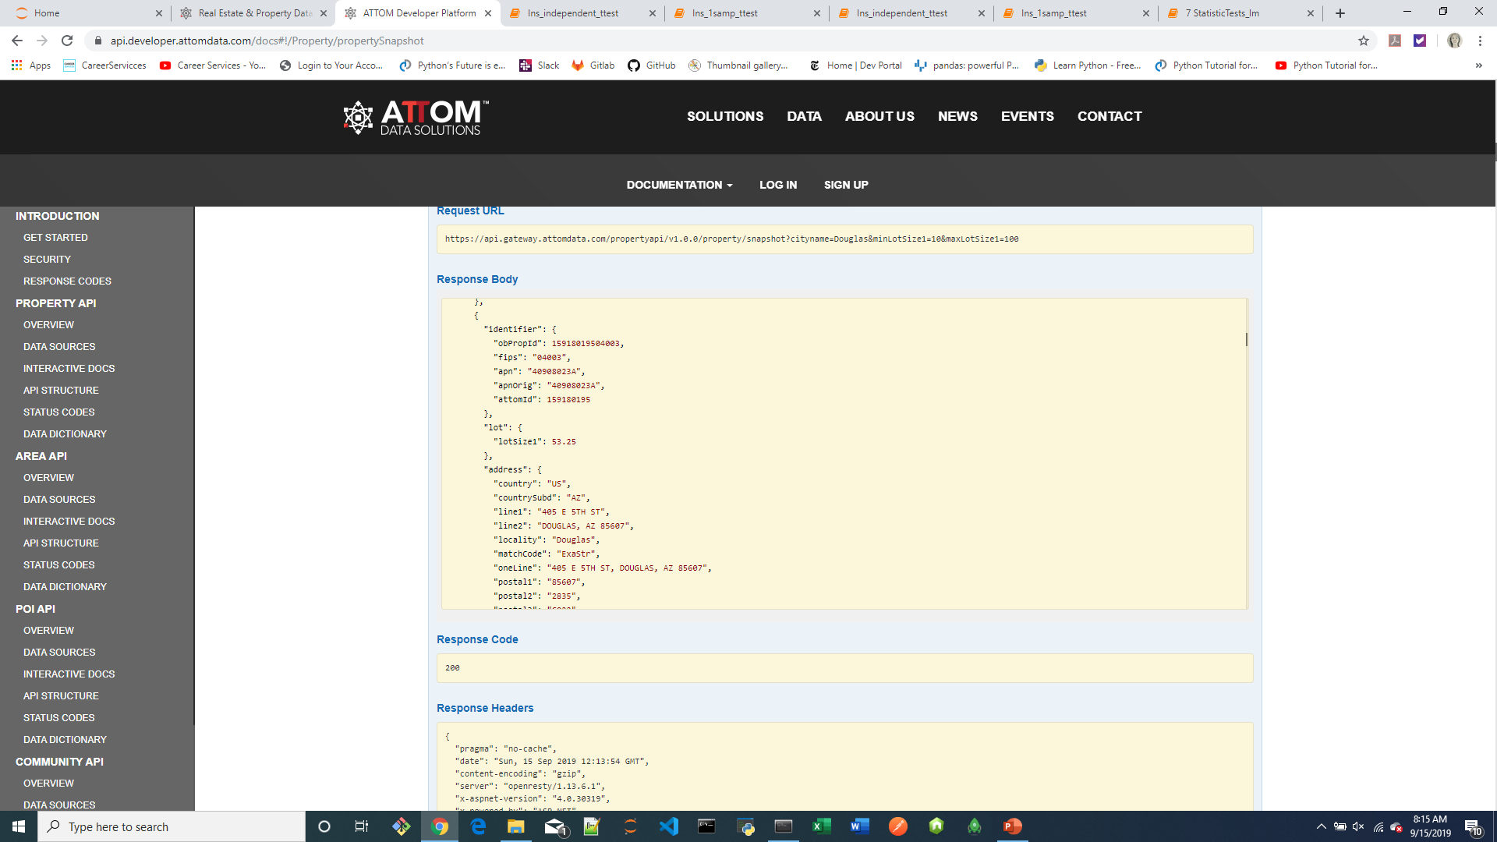
Study API End Points: Interactive Docs

Slide 5
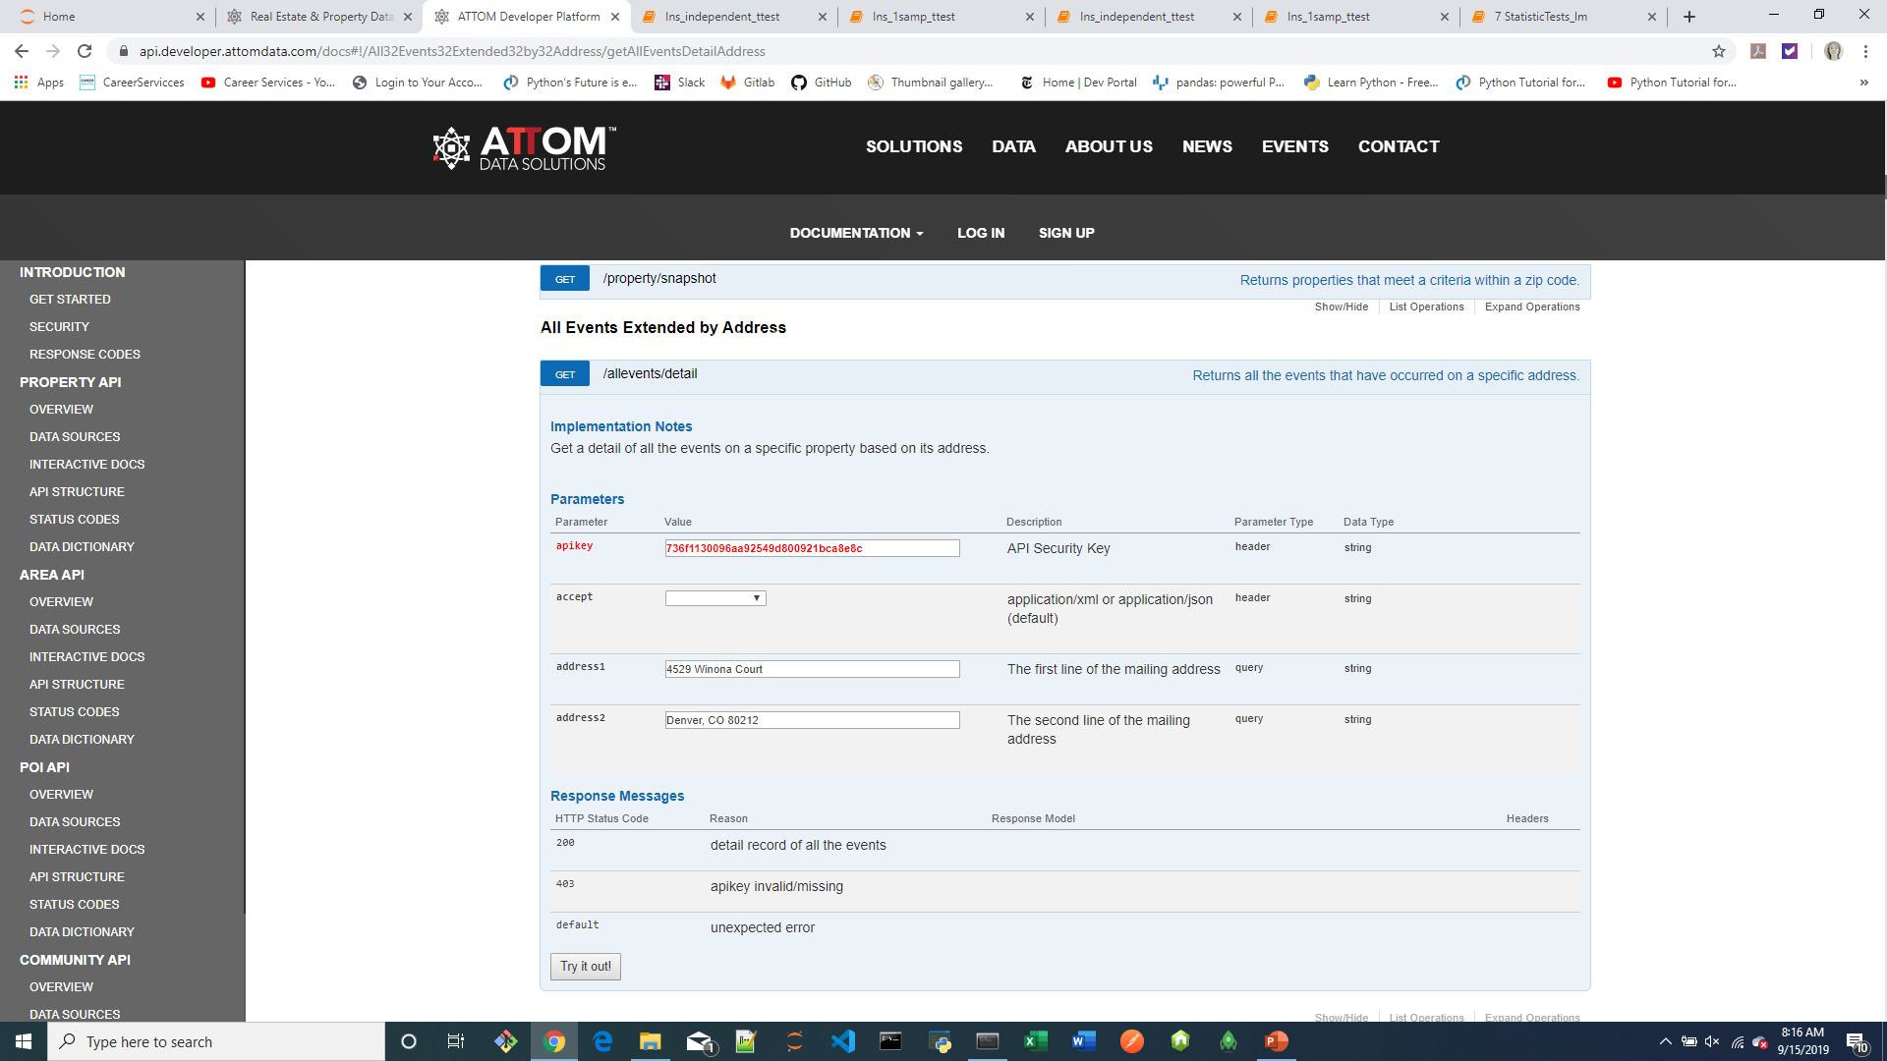
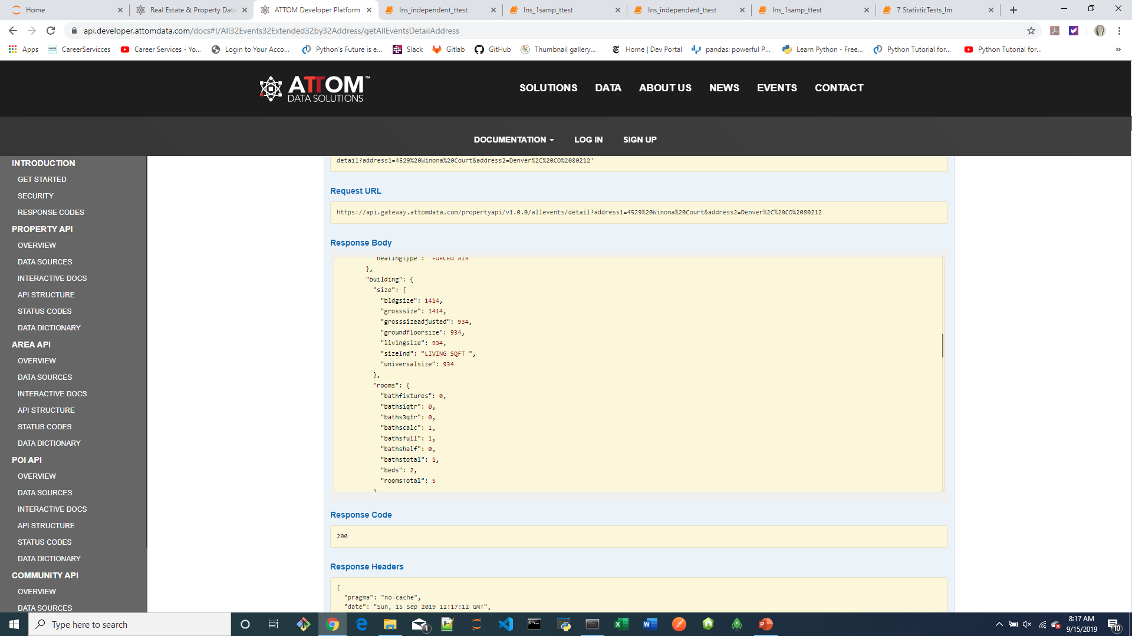
Study API End Points: Interactive Docs

Slide 6
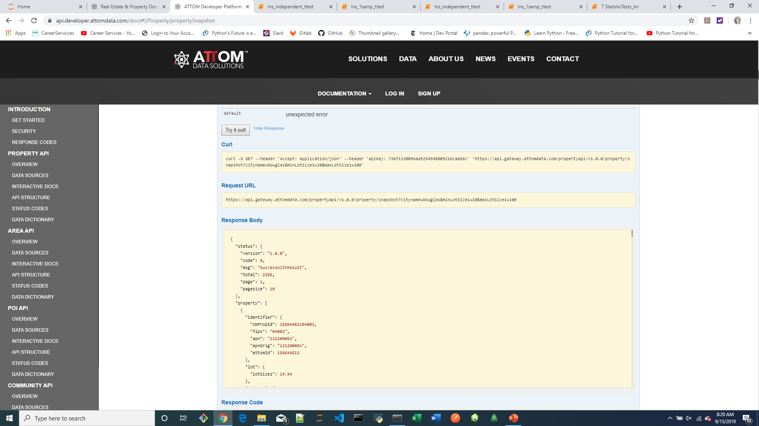
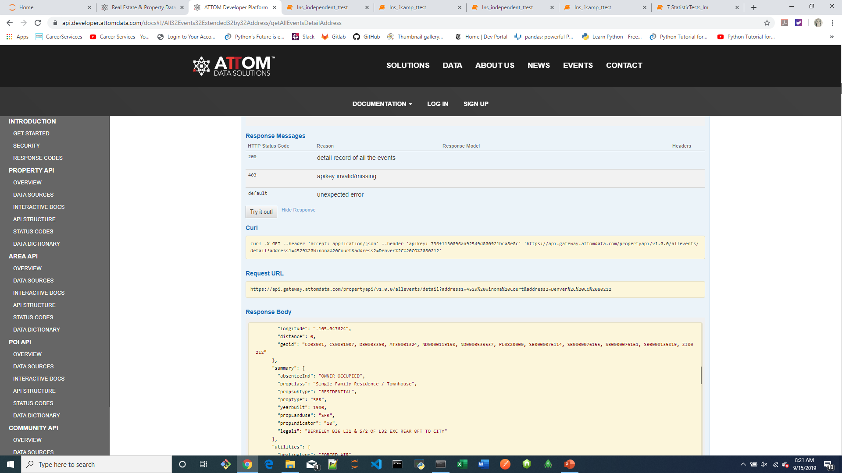
Study API End Points: Interactive Docs

Slide 7
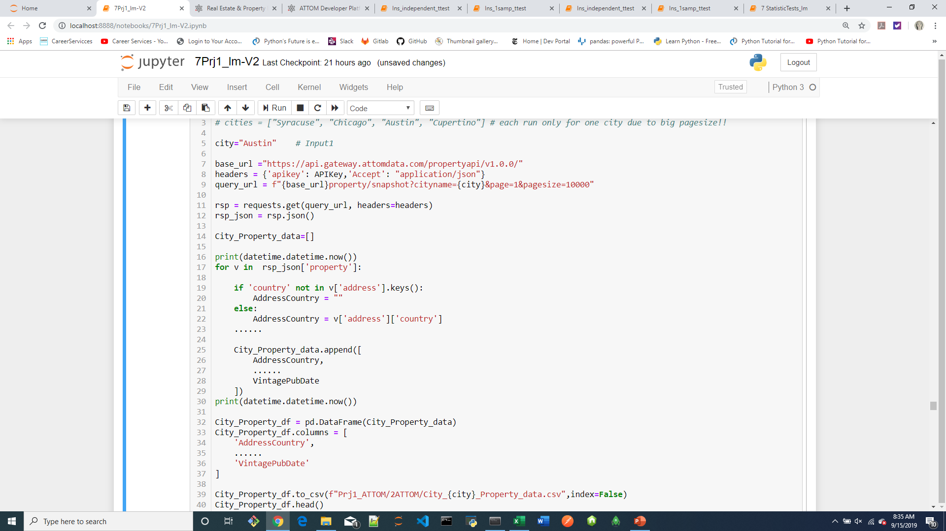

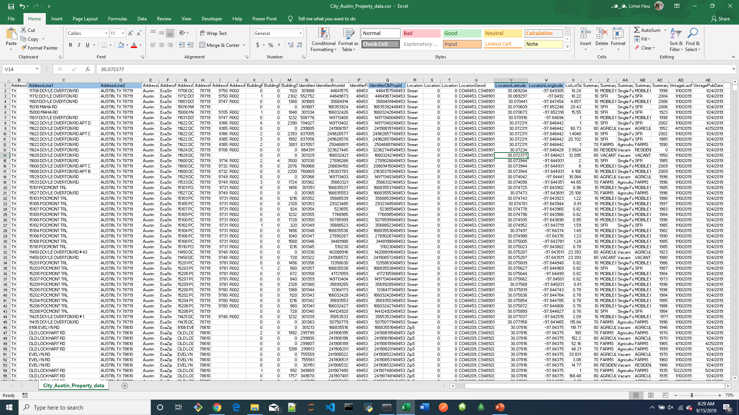
1st API Call

Slide 8
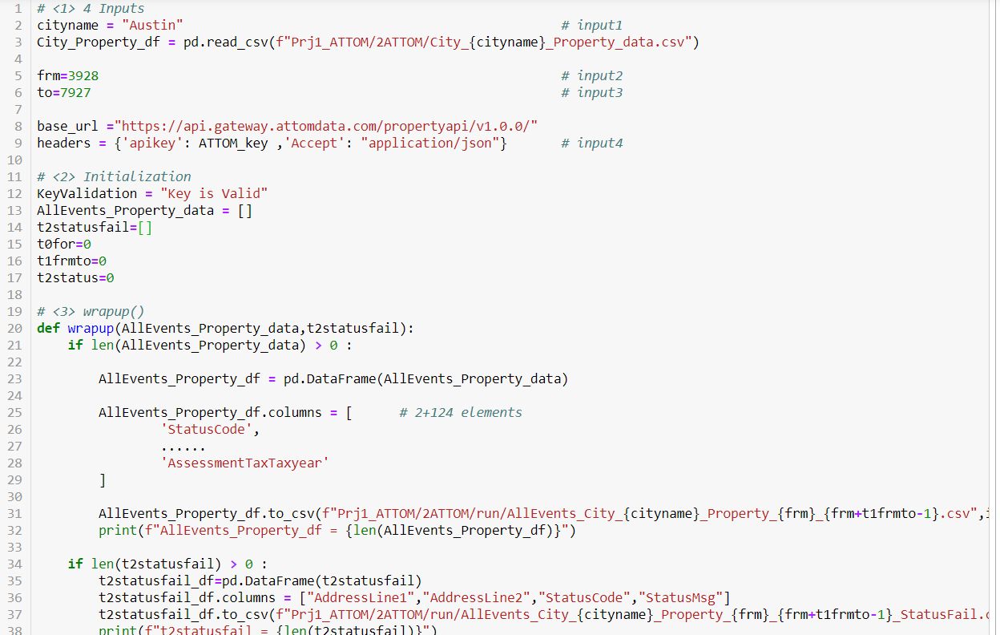
2nd API Call
# 200: {'status':{"code":"", "msg":"", ...}, {'property':[{},{},{} ]} }
# 403: {'Response': {'status':{"code":"", "msg":"", ...} } }

Slide 9
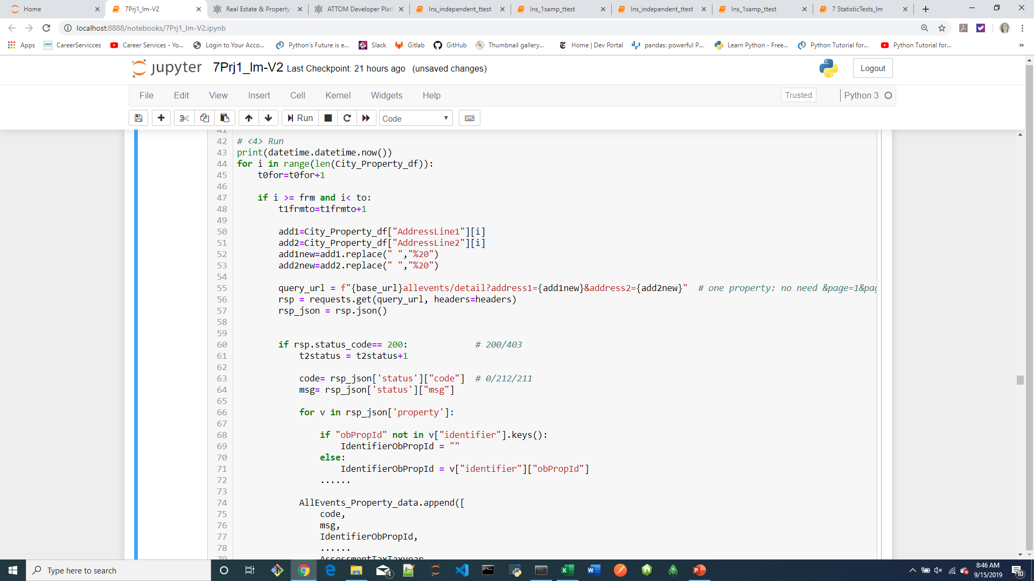
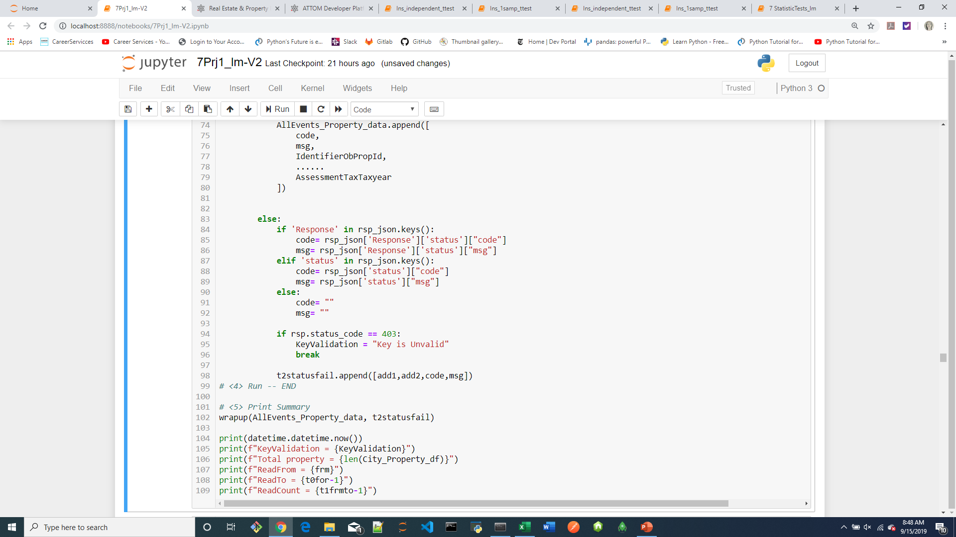
2nd API Call

Slide 10
Core Message/Hypothesis:
We wanted to find out if our randomly picked three cities would have any sort of correlation.
The main question we wanted to answer is:
Is there a significant difference in average yearly market value between the three cities, using significance level α = 0.05?

Slide 11
H_{o}: H_{A}:

Slide 12
Other questions we wanted to answer in the process:
What are other factors that go into the market value of a home?
Bedroom count?
Bathroom count?

Slide 13
Data Exploration and Clean-up Process:
Dropped the data frame from 124 to 12 columns
Renamed columns to more meaningful names
In some cases sorted the columns
In some cases converted the data type to facilitate sorting of the column

Slide 14
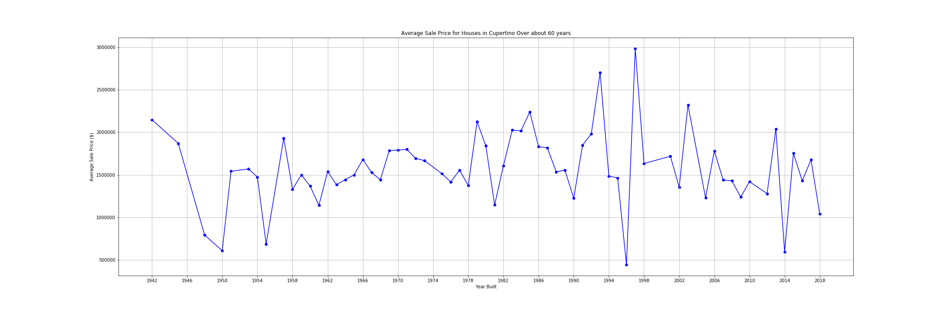
Are the houses selling?
Cupertino
Avg price between 1 to 2 M, drop from their 3 M.

Slide 15
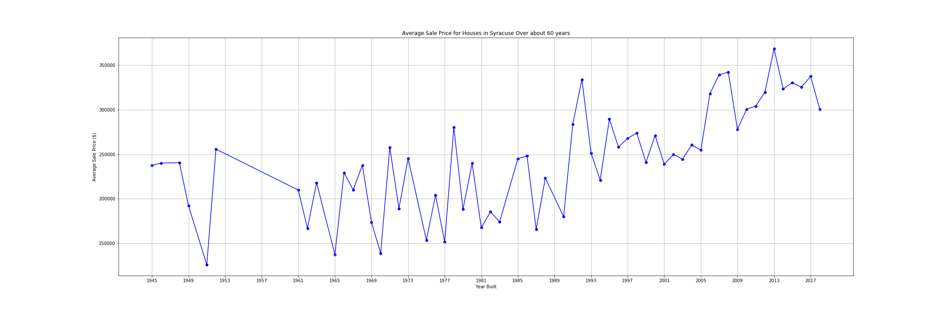
Are the houses selling? (cont.)
Syracuse
The market looks good here, the average price has gone up and is at a all time high.

Slide 16
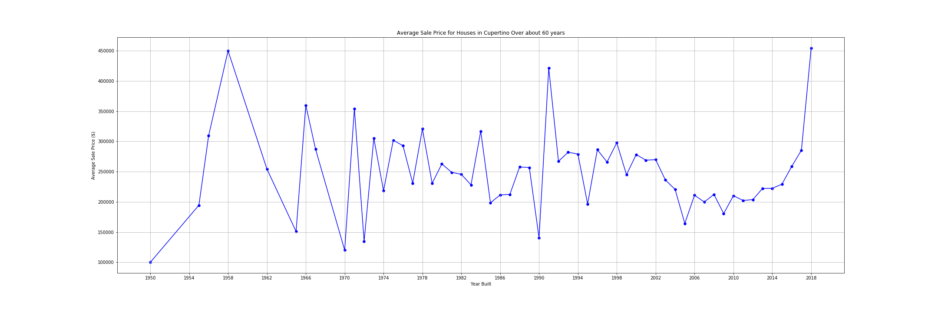
Are the houses selling? (cont.)
Austin
The market looks good here, the average price has gone up and is at a all time high at 450K.

Slide 17
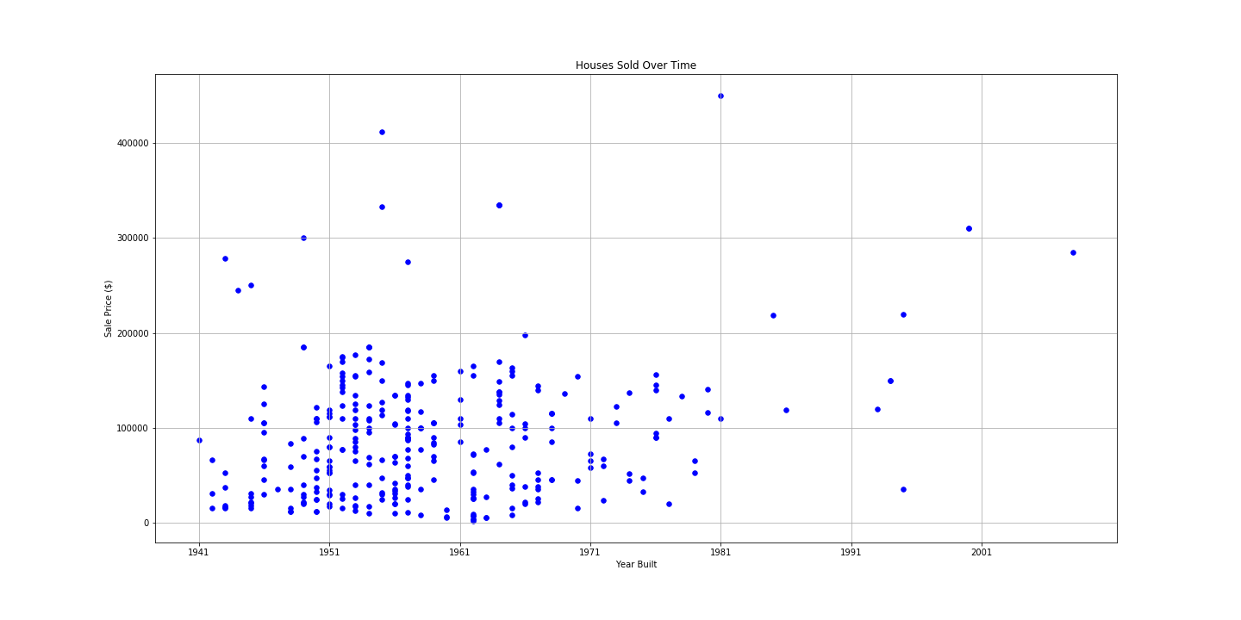
Are the houses selling (contd.)
Chicago
No. Overall a bad housing market, so no further analysis conducted.

Slide 18
What sold the most?
So, based on room count, bedroom count and bath count here’s our findings:
Cupertino: 8 rooms, 3 bedrooms,2 baths.
Syracuse: 6 rooms, 2 bedrooms, 2 baths.
Austin: No data room on room count or bedroom count, 2 baths.

Slide 19
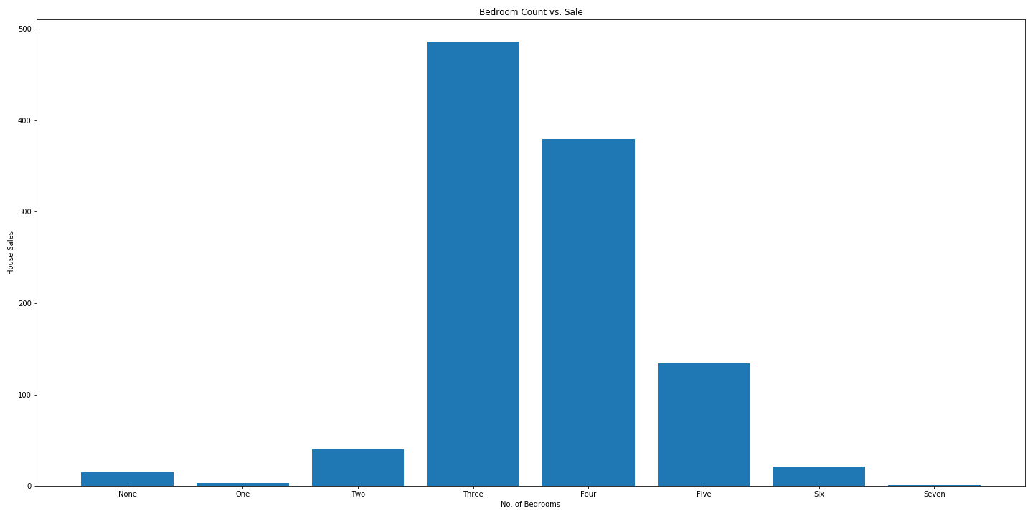
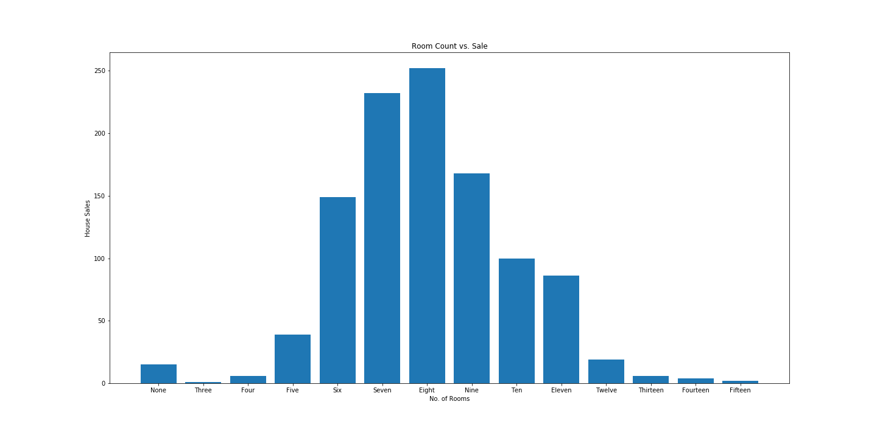
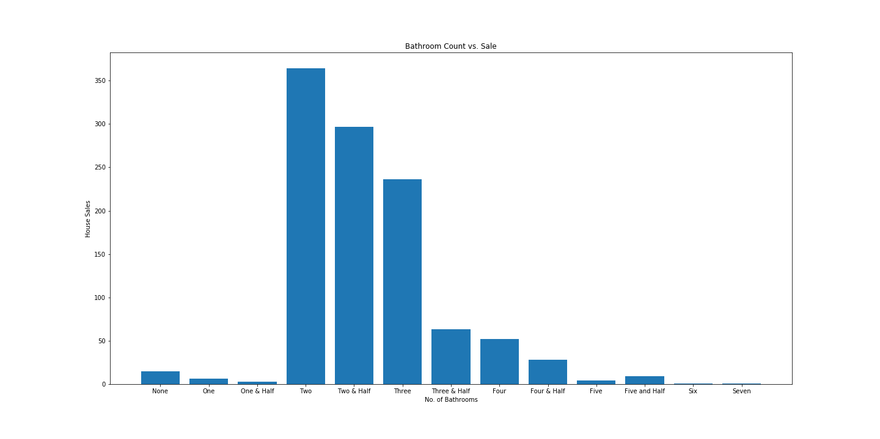
Cupertino

Slide 20
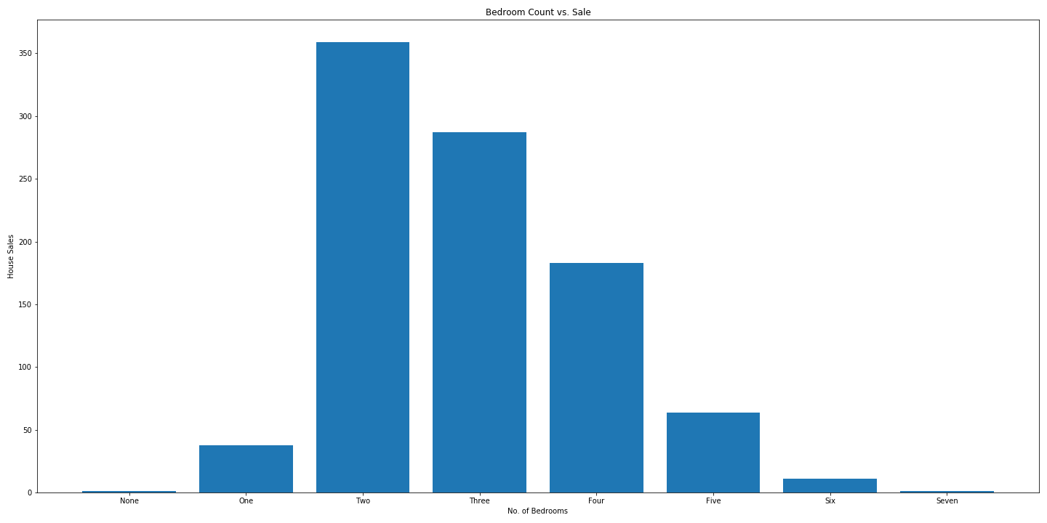
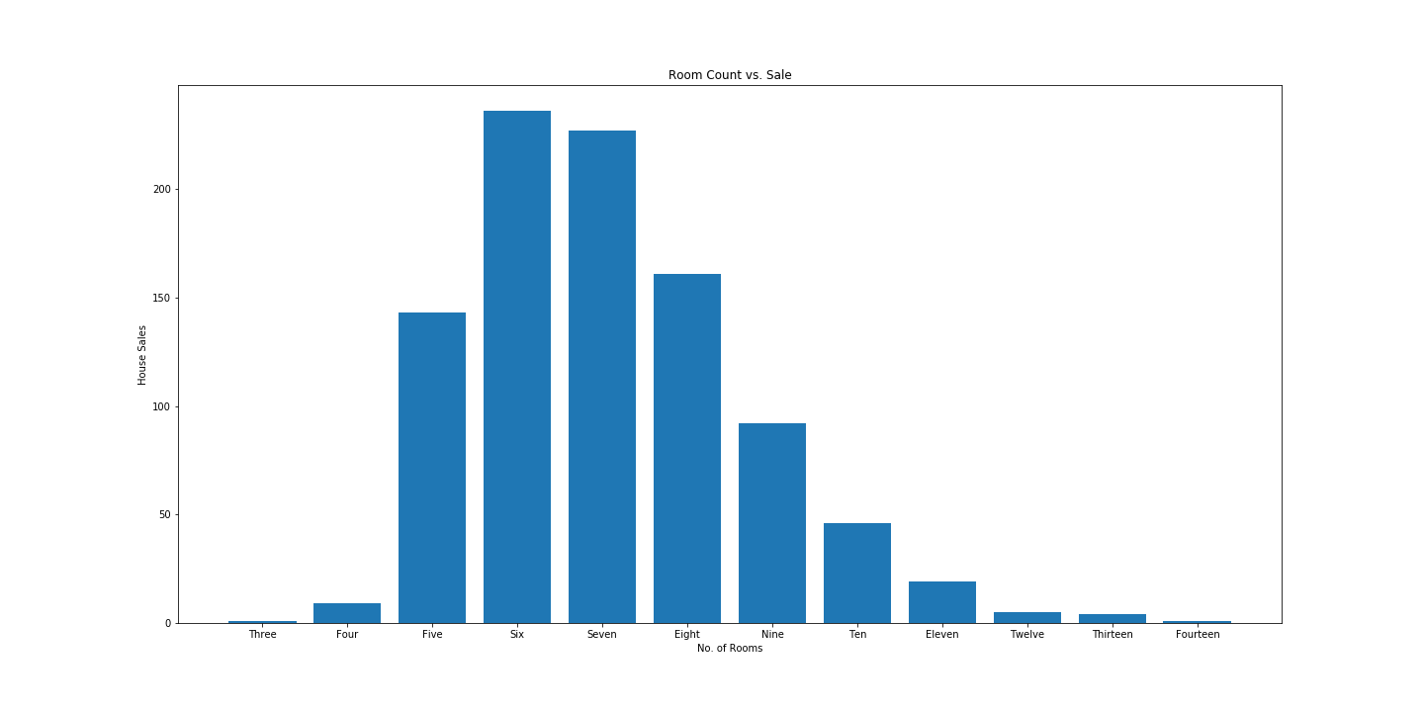
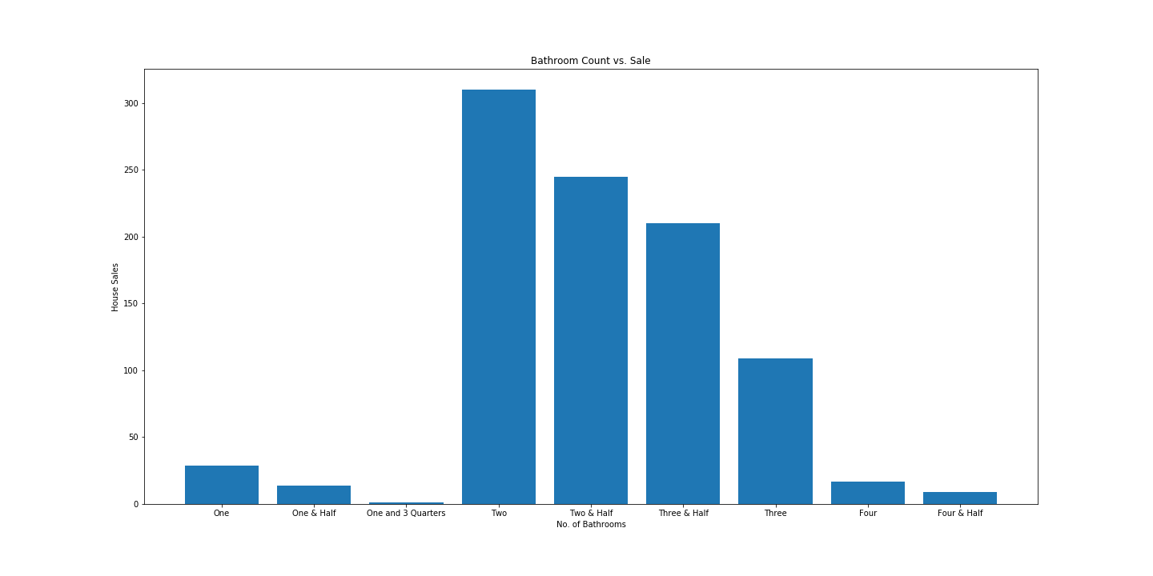
Syracuse

Slide 21
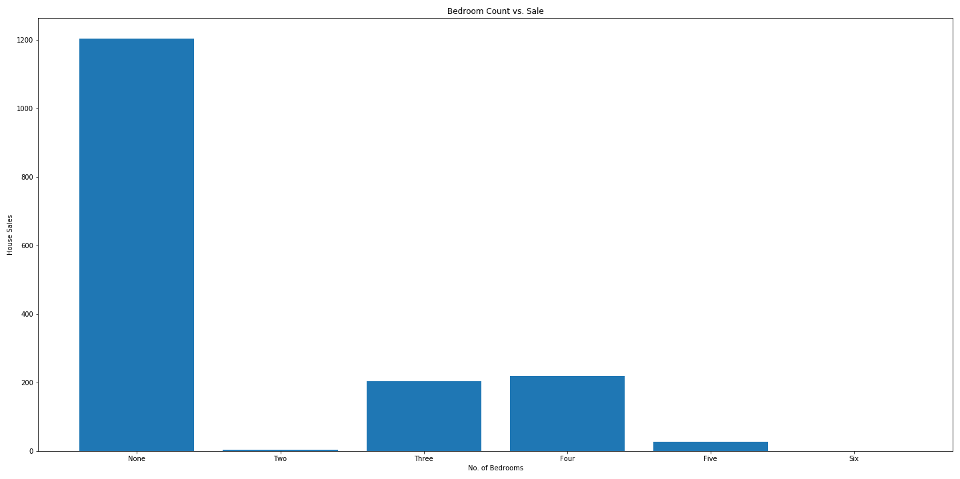
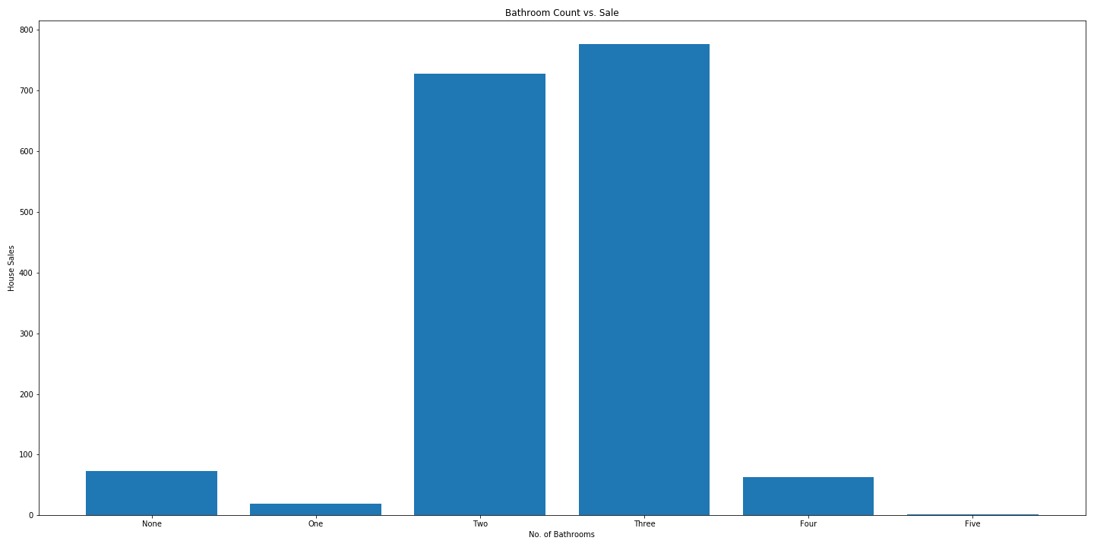
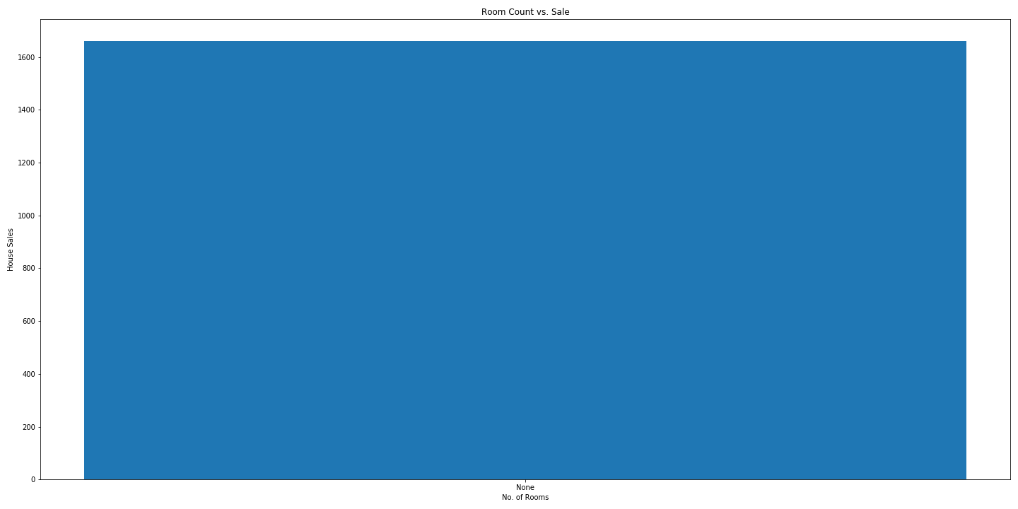
Austin

Slide 22
The Story:
Austin and Syracuse are top markets. People generally prefer mid size homes with 2 baths.
Is America ready for live work and play community?
…Maybe.

Slide 23
So we ask again… Is there a significant difference in average yearly market value between the three cities, using significance level α = 0.05?

